Slide 1
Production Monitoring with Azure Monitor
Matt McCleary

Slide 2
Agenda
01
02
03
Production Monitoring
Azure Monitor Enablement
.NET Aspire → Azure Monitor
04
05
Azure Monitor Roadmap
Resources

Slide 3
Production Monitoring

Slide 4
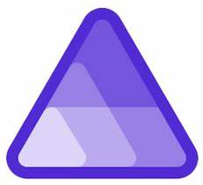
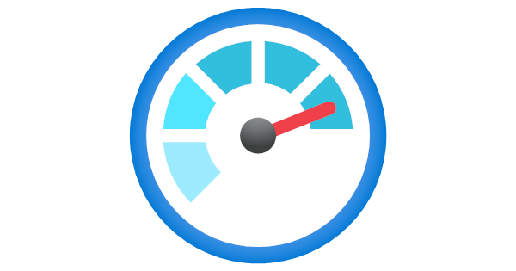
What’s distinct about production monitoring?
.NET Aspire Viewer
Azure Monitor
Real-time
Runs locally
Simplicity
OTLP Native
No cost
High availability cloud service
Robust data storage and query layer
Recording Rules, Alerting Engine, and Action Groups
Full stack (Infra + App)
OOB Experiences and Custom Dashboarding
Central configuration for governance and at-scale management
Supports security protocols such as data encryption
Advanced Diagnostics (Profiling, AIOps, etc)
Extensive Integrations with Slack, ServiceNow, Grafana, etc.

Slide 5
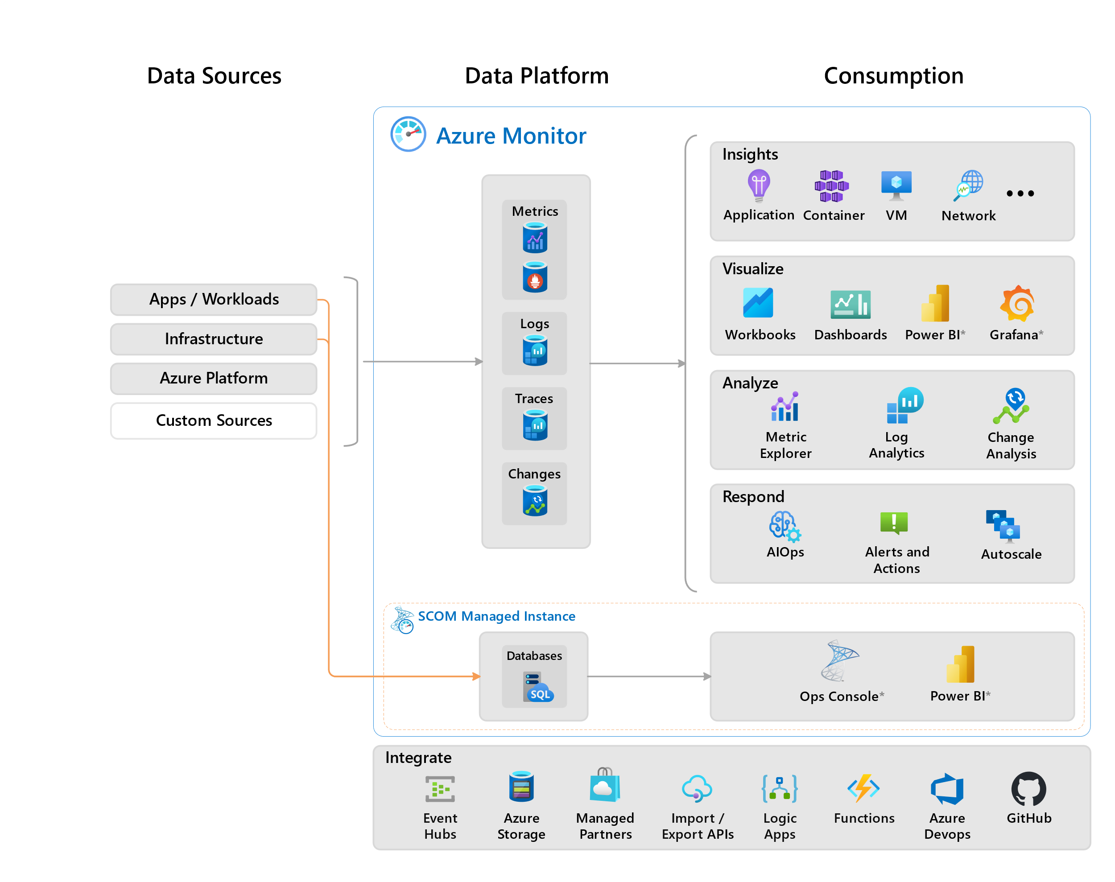
Azure Monitor Data Platform
Logs/Traces (Log Analytics)
Retention up to two years hot; 12 years archive
Up to 500,000 records per query
Scales up to 1,000 GB/day per App Insights Resource (or higher upon request).
Metrics (Azure Monitor Workspace)
Scales up to 50 million active time series
50 GB data ingestion per minute
Data retention up to 18 months
Use PromQL + Grafana

Slide 6
Enablement

Slide 7
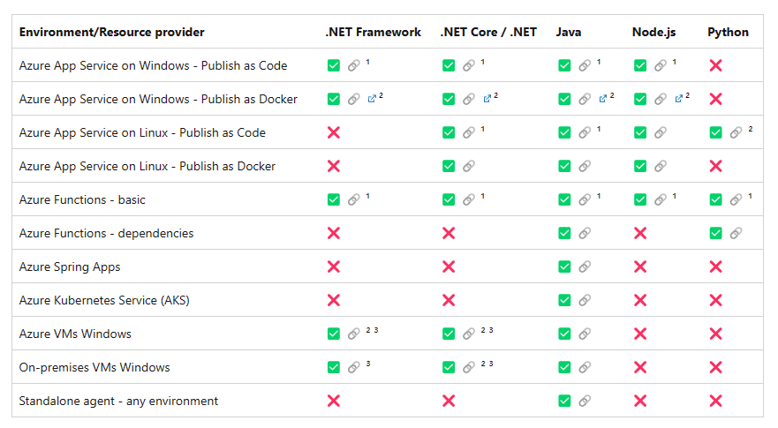
Paths to Enablement
Auto-Instrumentation
Manual Instrumentation
Native to Azure
At-scale enablement
Azure Monitor OpenTelemetry Distro
Get started with a single line of code.
OTel
Tracing
SDK
Sampling Processor
Instrumentation Libraries
Instrumentation Libraries
OTel
Metrics
SDK
Azure Monitor Exporter
OTel
Logging
SDK
OpenTelemetry Component (yellow)
Azure Component (magenta)
Distro Package Boundary (blue)
Public Preview Planned Sep 2024

Slide 8
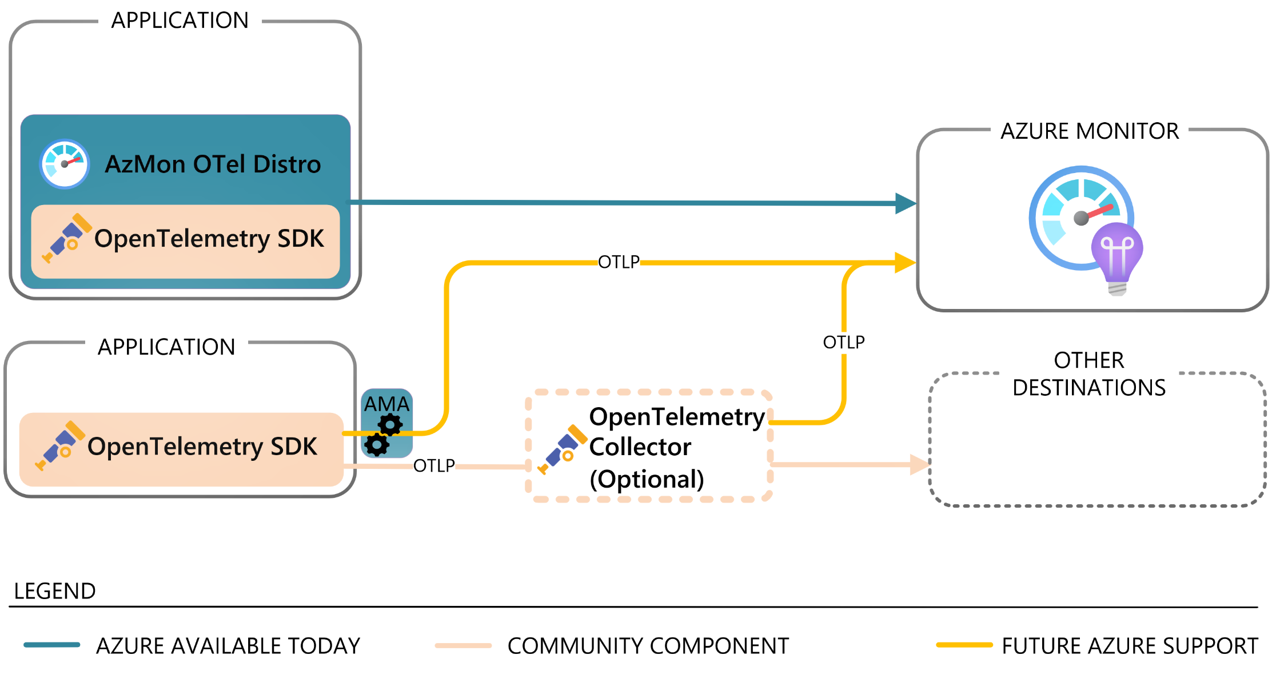
Data Collection with OpenTelemetry
❶
Investments
❶ Azure Monitor OpenTelemetry Distro
❷ Native OTLP ingestion with AMA*
❸ Direct OTLP ingestion*
* In Development
❸
❷

Slide 9
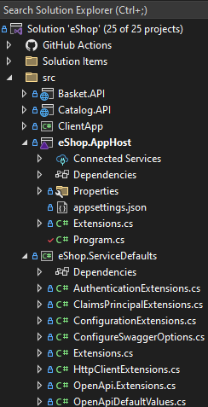

How to get started in eShop
❶
Download Package Azure.Monitor.OpenTelemetry.AspNetCore
❷
private static IHostApplicationBuilder AddOpenTelemetryExporters(this IHostApplicationBuilder builder)
{
if (!string.IsNullOrEmpty(builder.Configuration["APPLICATIONINSIGHTS_CONNECTION_STRING"]))
{
builder.Services.AddOpenTelemetry().UseAzureMonitor();
}
return builder;
}
❶
❸
{
"ConnectionStrings": {
"myInsightsResource": "YOUR_CONNECTION_STRING“ //Copy/paste from Application Insights Resource
}
}
❷
❸
❹
var insights = builder.AddConnectionString("myInsightsResource", "APPLICATIONINSIGHTS_CONNECTION_STRING");
// Services
var identityApi = builder.AddProject<Projects.Identity_API>("identity-api", launchProfileName)
.WithReference(insights) // Copy/paste to each service in list
.WithExternalHttpEndpoints()
.WithReference(identityDb);
❹

Slide 10

Demo: Enablement and Views

Slide 11
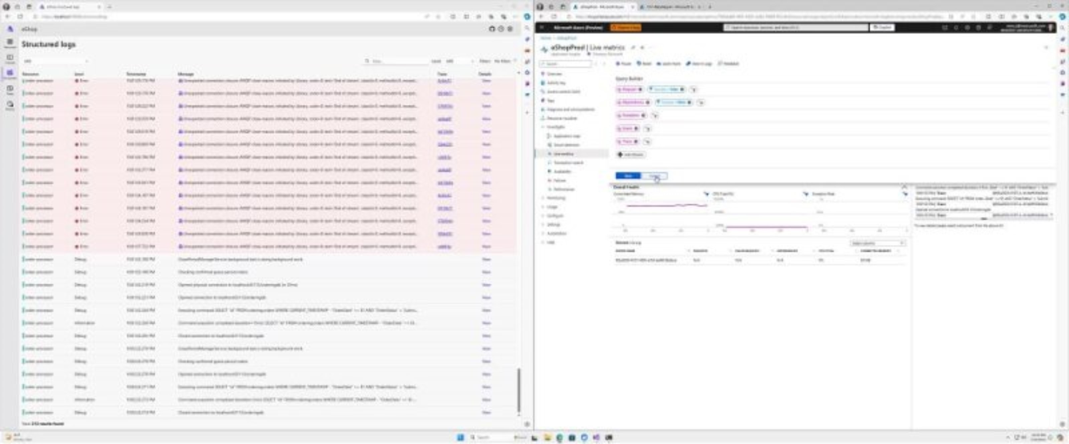

Slide 12
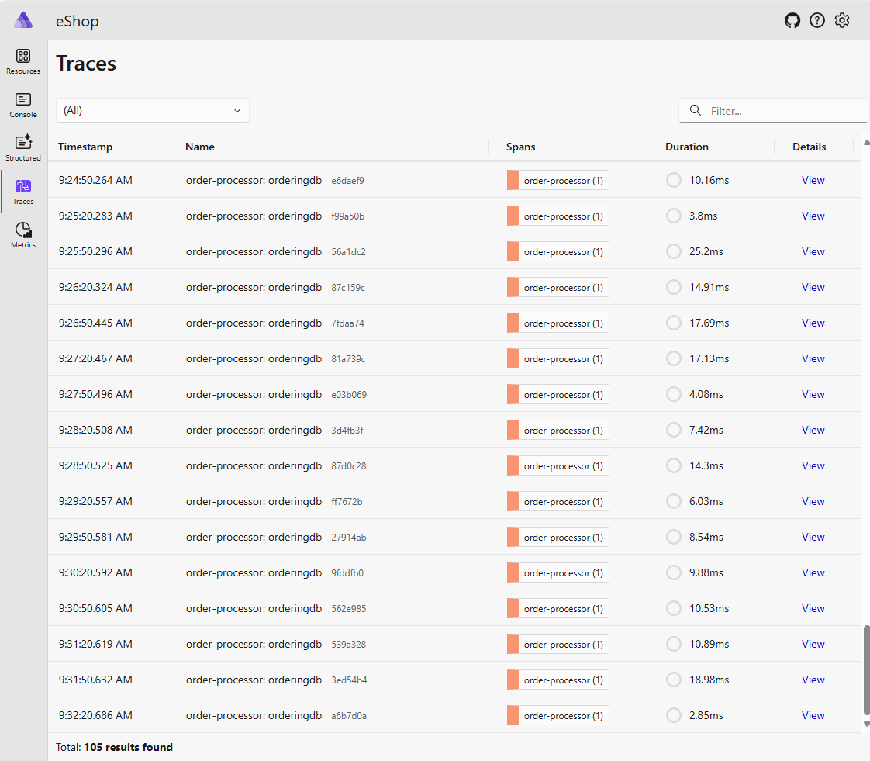
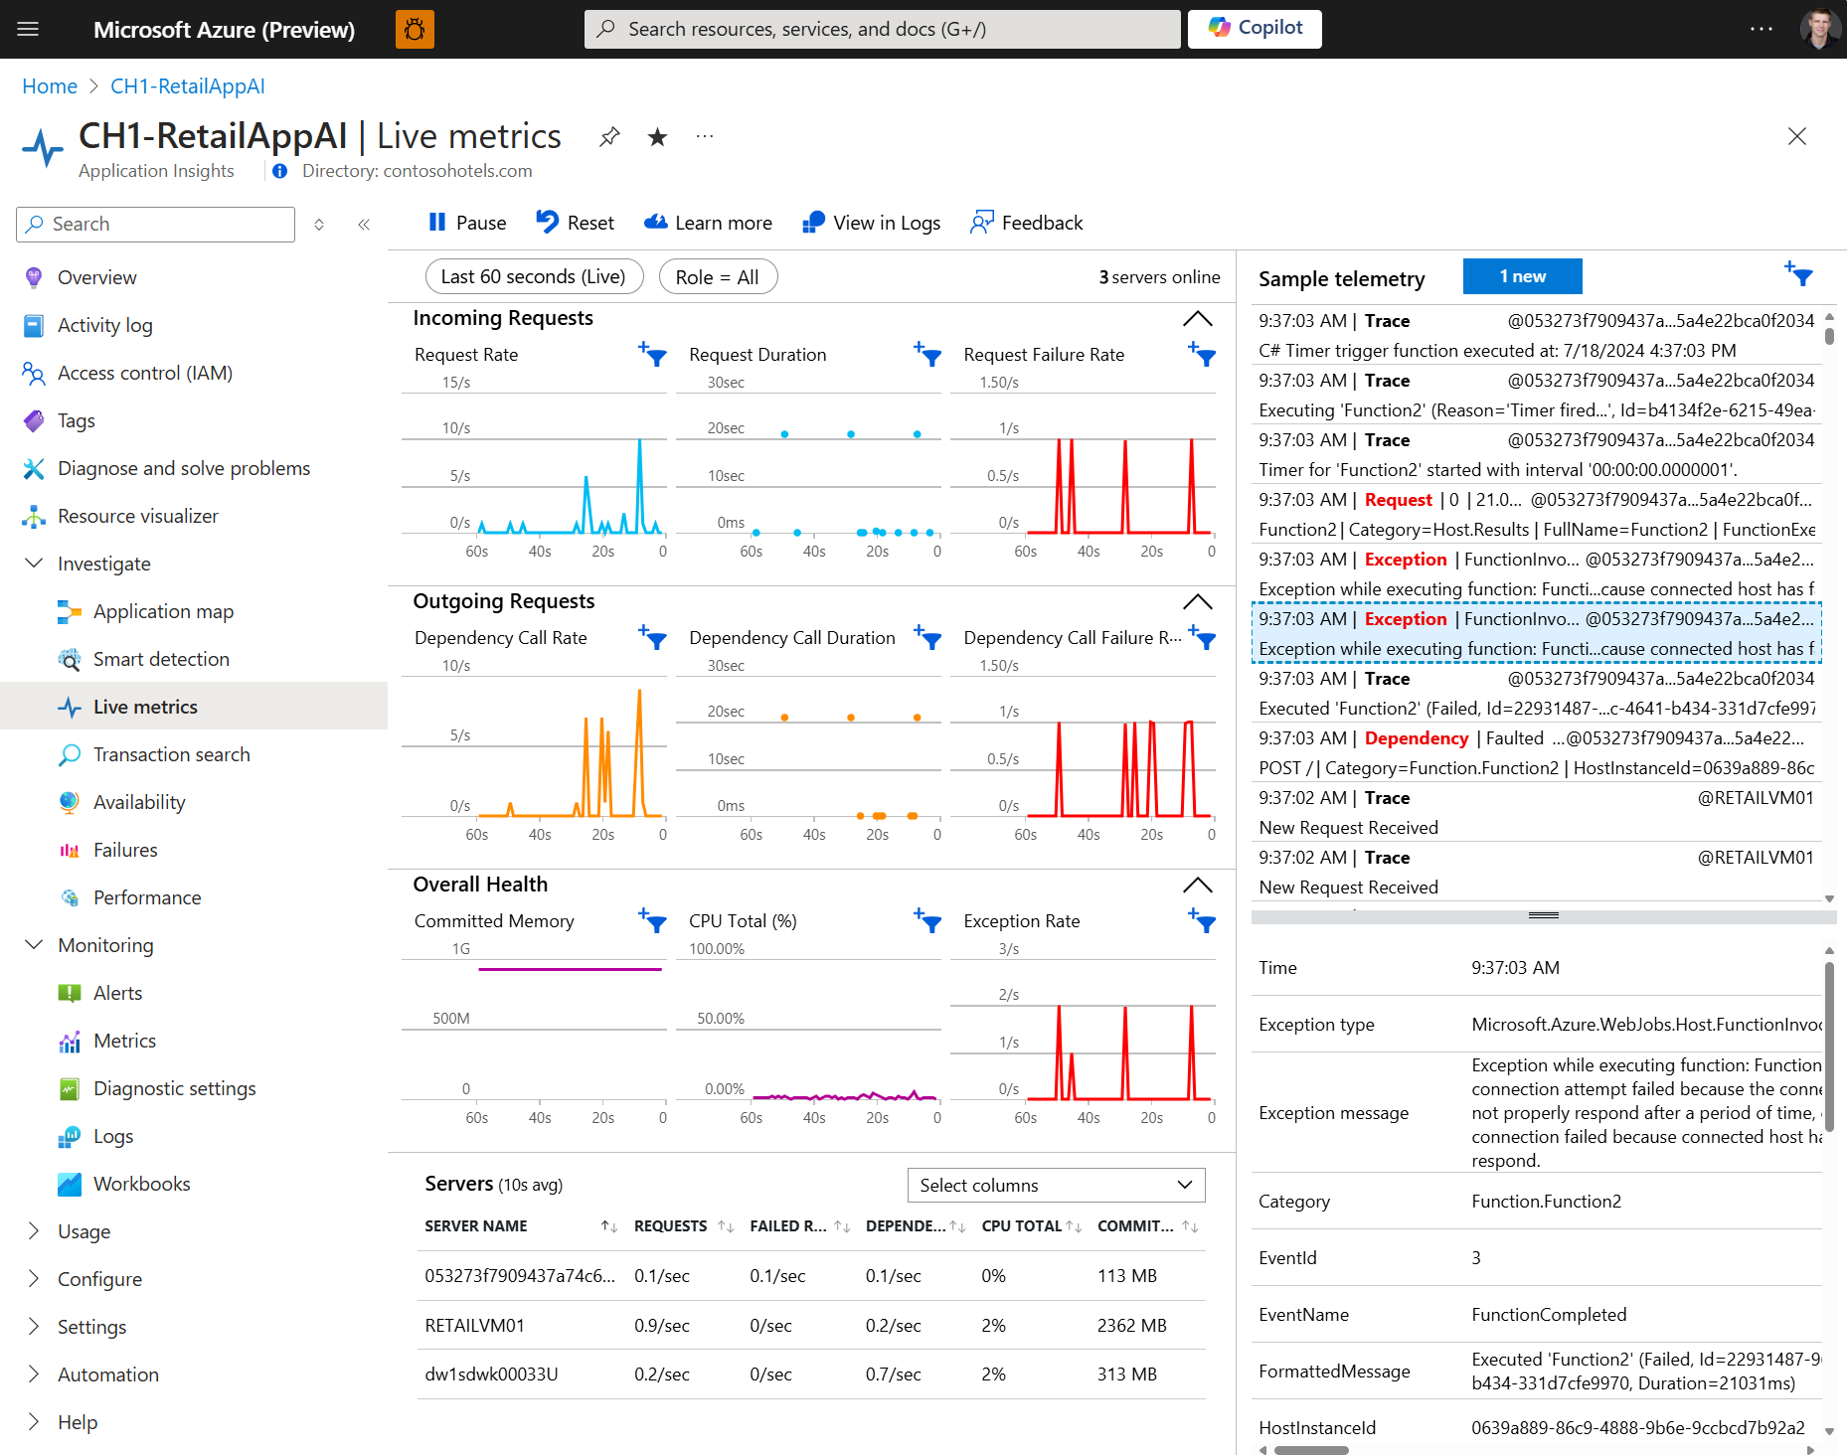
Live metrics: Sample telemetry
.NET Aspire Viewer
Application Insights
Local running hosted endpoint
Separate views for structured logs and traces
Cloud Service with one-second latency
Single stream of telemetry with filtering

Slide 13
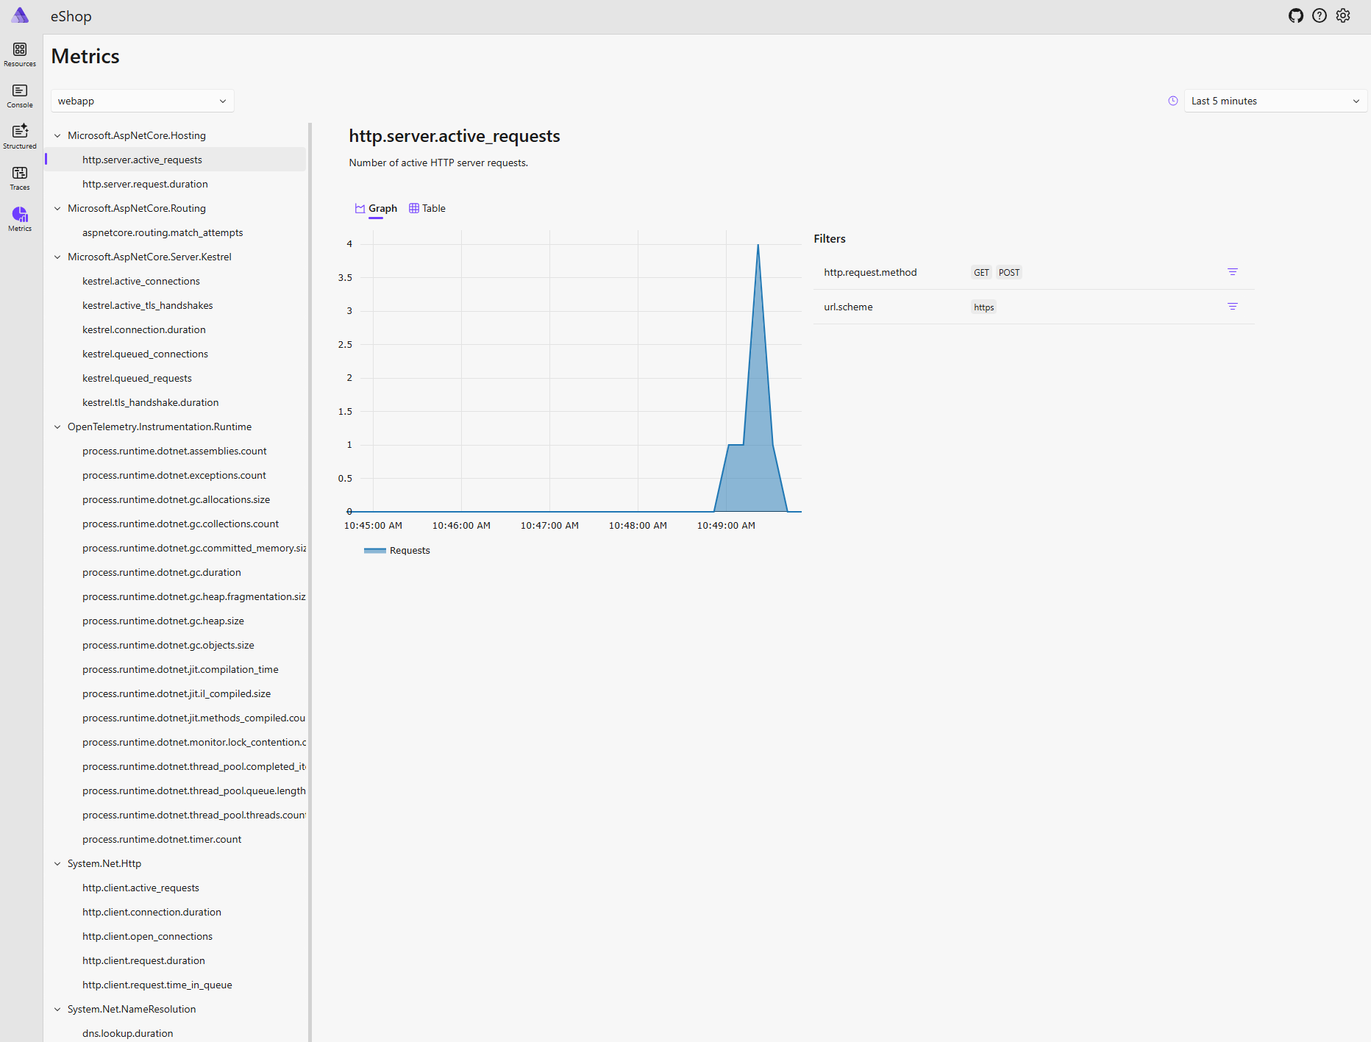
Live metrics: Aggregates
.NET Aspire Viewer
Application Insights
Select a Metric & Service
All OpenTelemetry Metrics
Aggregate with Service Filters
Curated set of metrics

Slide 14
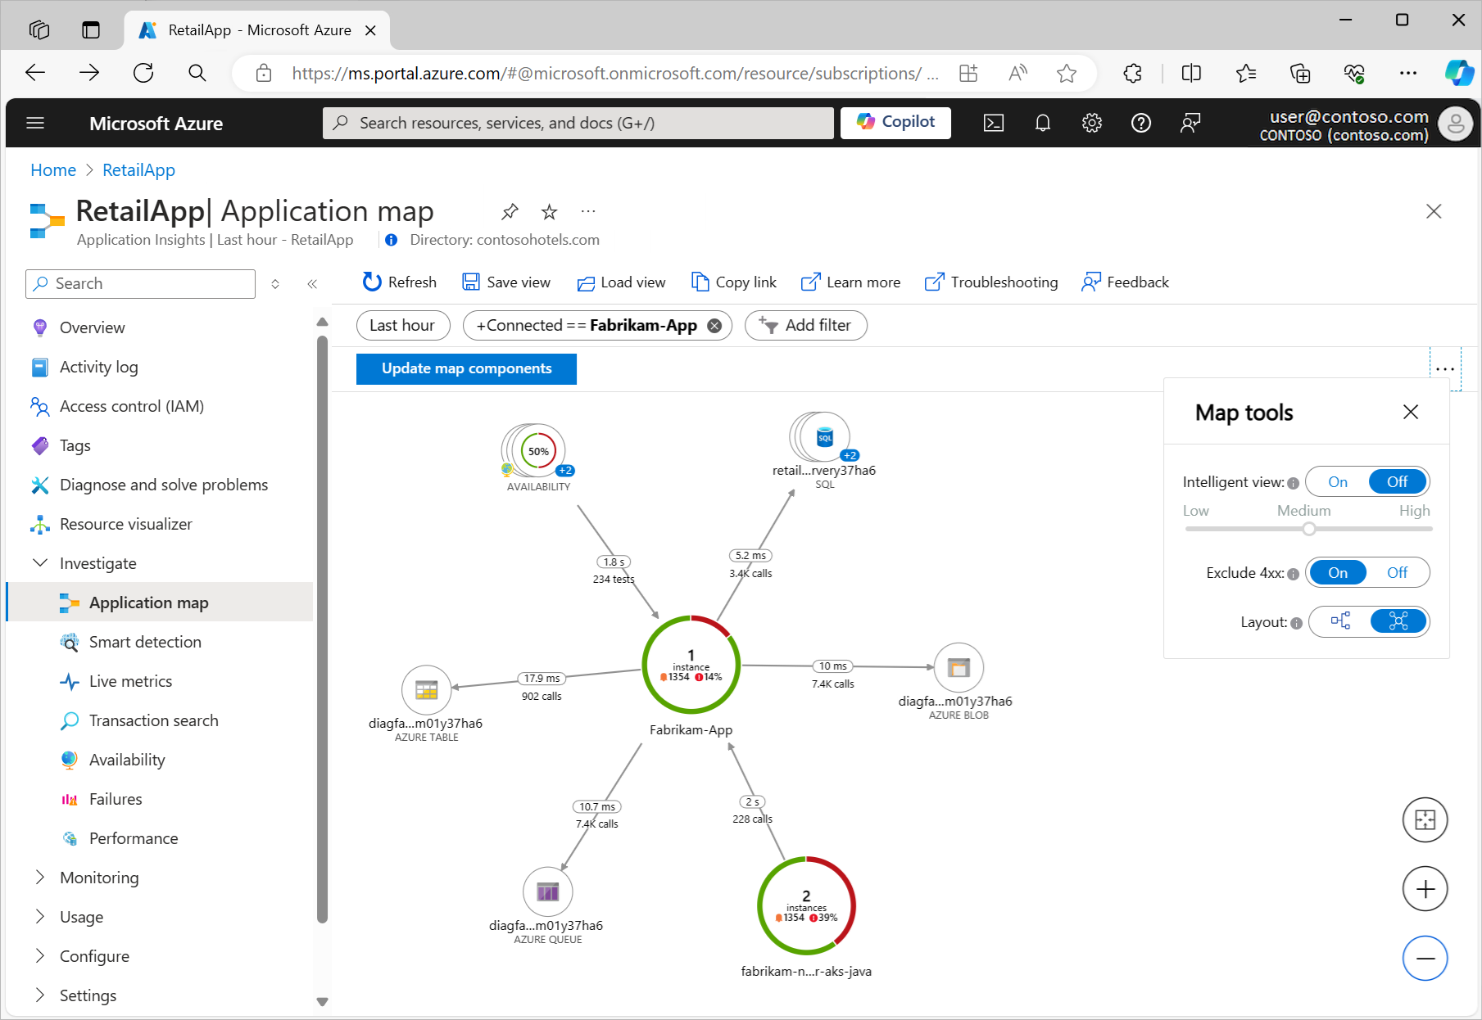
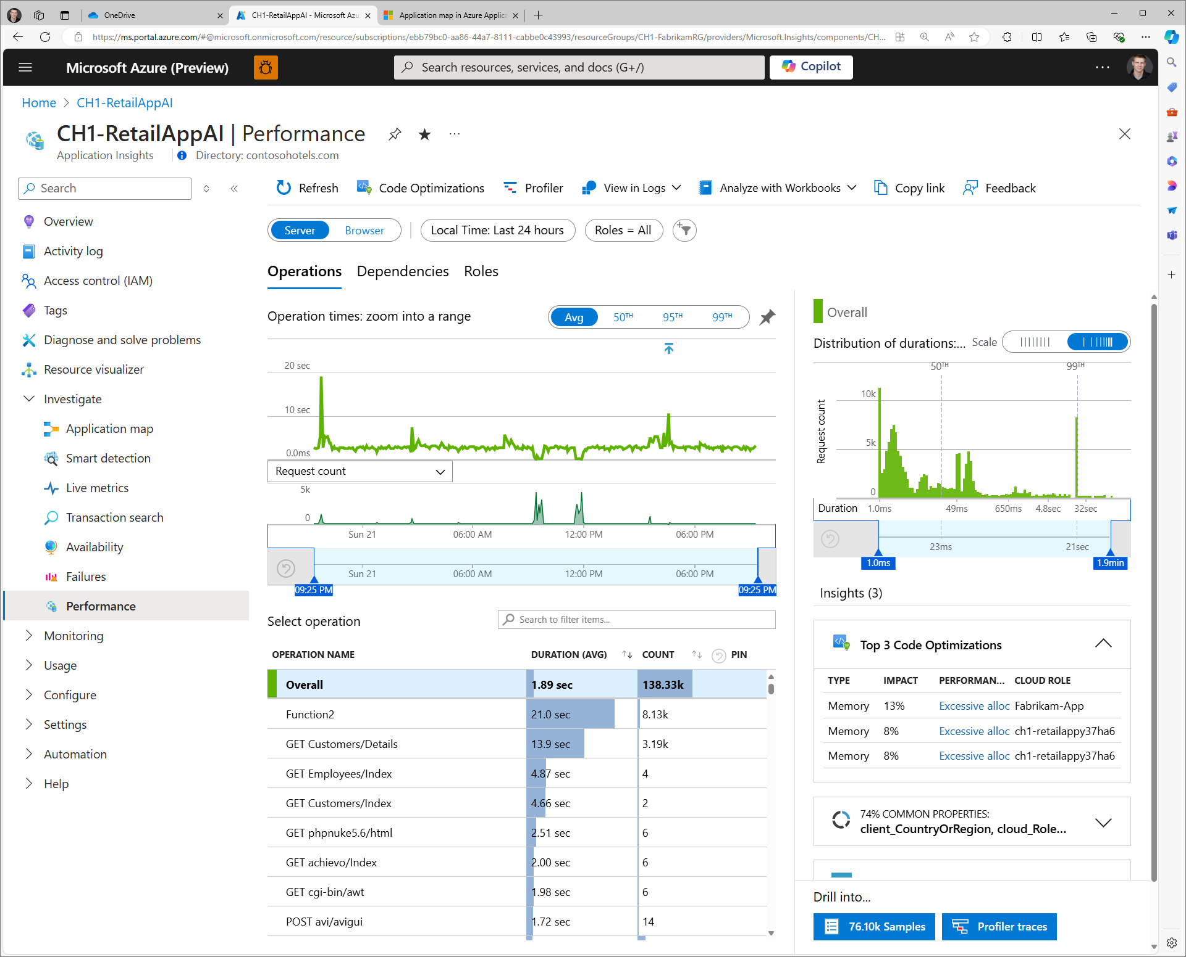
Diagnostic Views
Application Map
Performance View
Topological View
Filter to specific nodes/services
Red denotes failures
Slow requests/dependencies filtered by any dimension
See common properties (city, service, etc.)
Code optimization recommendations + Profiles

Slide 15
Roadmap

Slide 16
OpenTelemetry-based Collection
2024 Quarterly Estimated Releases
 | By May | By September | By December | Future
❶ Instrumentation
AzMon OpenTelemetry Distro | Live Metrics | Migration support for classic SDK to OTel Distro | 100% Feature Parity | Sunset classic AI SDK Distros send OTLP directly OTLP metrics supported GA AKS Auto-Instrumentation
AKS Auto-Instrumentation |  | Public Preview: .NET/Java/Node | Add support for Python
❷ Agent
AMA Collects OTLP | -- | Private Preview | Public Preview | GA
AKS Add-On collects OTLP | --
❸ Direct Ingress
Serverless platforms support OTLP | Public preview: Functions & ACA (owned by them) |  | Private Preview of direct OTLP ingestion | GA Compute centric AI Experiences (AI resource optional)
Direct OTLP Ingestion | -- | --

Slide 17
Observability Roadmap 2024
VM Performance & Reliability Diagnostics
Cloud Native & Edge Observability
Standards based monitoring with OpenTelemetry, Grafana & Prometheus
Workload/Service Group Observability
Rich SLI/SLO Platform with Health Models & Alerts
Cost-optimized Log Tiers & Simplified Querying
AIOps with ML & LLM Scenarios

Slide 18
Resources
https://learn.microsoft.com/azure/azure-monitor/app/app-insights-overview
https://techcommunity.microsoft.com/t5/azure-observability-blog/making-azure-the-best-place-to-observe-your-apps-with/ba-p/3995896
Application Insights Overview
Azure + OpenTelemetry Blog
https://learn.microsoft.com/azure/azure-monitor/app/opentelemetry-enable
https://learn.microsoft.com/azure/azure-monitor/app/codeless-overview
Manual Instrumentation with the Azure Monitor OpenTelemetry Distro
Auto-Instrumentation Overview
https://learn.microsoft.com/azure/azure-monitor/app/live-stream
https://learn.microsoft.com/azure/azure-monitor/service-limits
Live Metrics Overview
Azure Monitor Platform Characteristics + Service Limits
https://github.com/dotnet/eshop
OTel@microsoft.com
eShop Demo
Emails go to me, Matt McCleary. ☺

Slide 19
.NET Aspire Developers Day
Start your learning journey:
aka.ms/dotnetAspireDevDay/Collection

